Slide 1
Report on Northwind Sales Analysis
Prepared by Shakil Ahammed

Slide 2
In this project I have utilized SQL queries to solve questions that were related to Northwind sales.

Slide 3
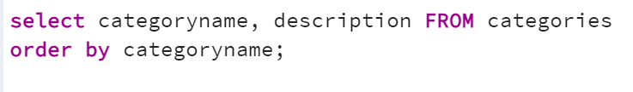
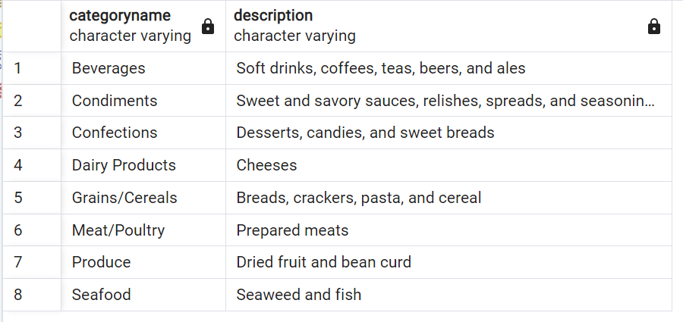
1. Show the category name and description from the categories table sorted by category name.

Slide 4

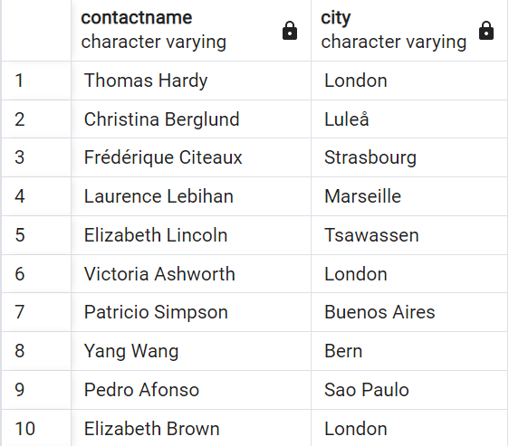
2. Show all the contact name, city of all customers which are not from
'Germany', 'Mexico', 'Spain’.

Slide 5
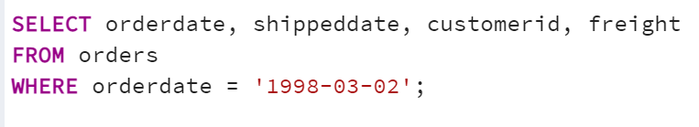
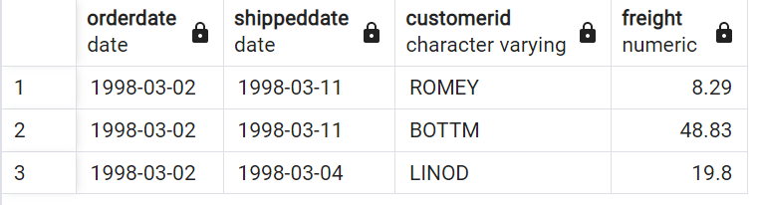
3. Show order date, shipped date, customer id, Freight of all orders placed
on 1998-03-02.

Slide 6
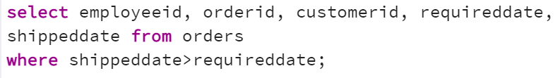
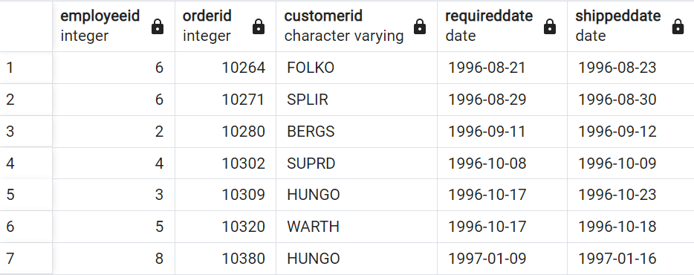
4. Show the employee id, order id, customer id, required date, shipped date
from all orders shipped later than the required date.

Slide 7

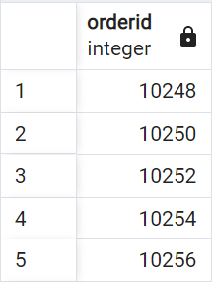
5. Show all the even numbered Order id from the orders table.

Slide 8
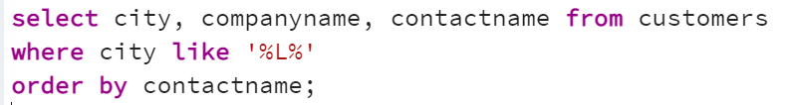
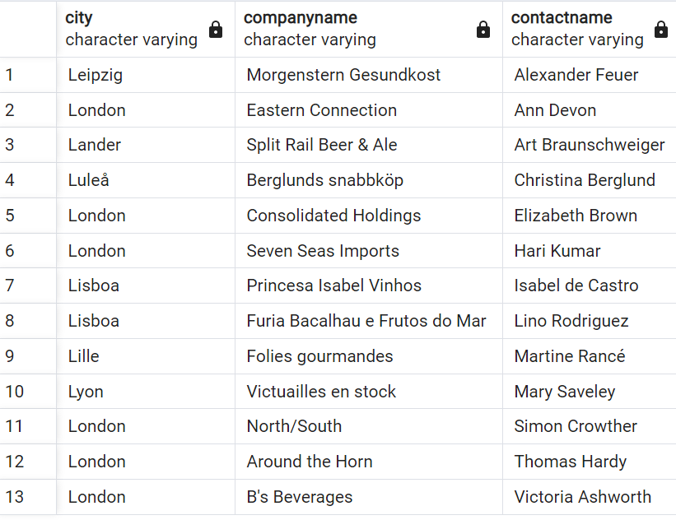
6. Show the city, company_name, contact_name of all customers from cities which
contains the letter 'L' in the city name, sorted by contact_name.

Slide 9

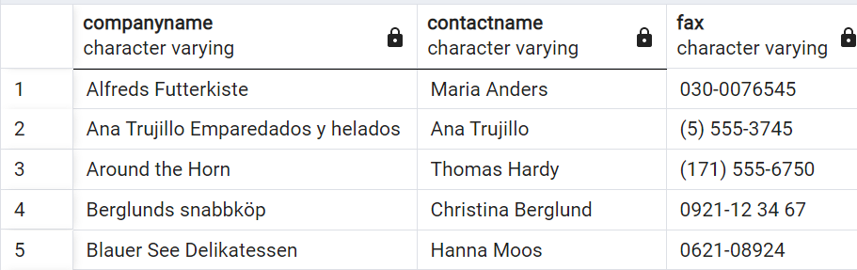
7. Show the company_name, contact_name, fax number of all customers that has a
fax number. (not null).

Slide 10
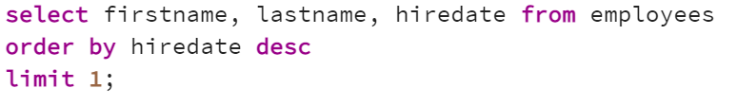
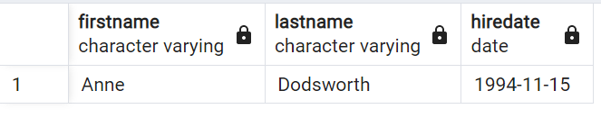
8. Show the first_name, last_name. hire_date of the most recently hired employee.

Slide 11
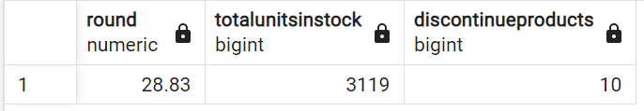
9. Show the average unit price rounded to 2 decimal places, the total units in
stock, total discontinued products from the products table.

Slide 12
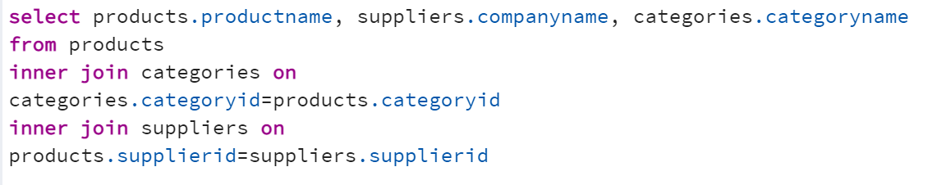
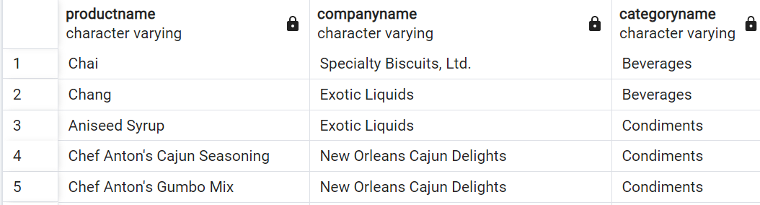
10. Show the ProductName, CompanyName, CategoryName from the products, suppliers, and categories table.

Slide 13
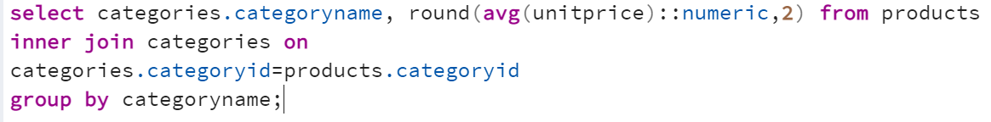
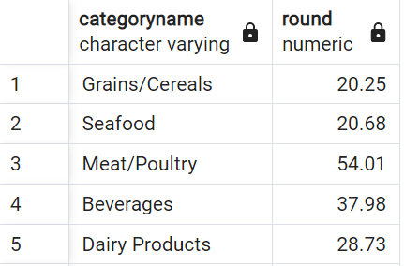
11. Show the category_name and the average product unit price for each category
rounded to 2 decimal places.

Slide 14
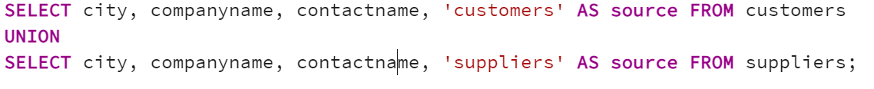
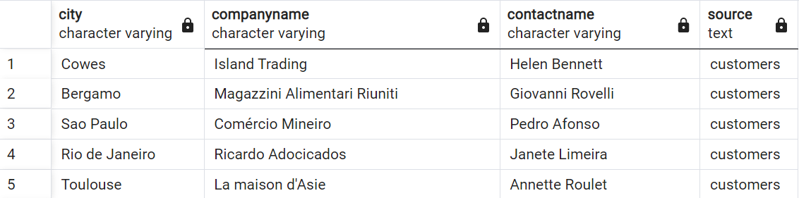
12. Show the city, company_name, contact_name from the customers and suppliers
table merged together. Create a column which contains 'customers' or 'suppliers'
depending on the table it came from.

Slide 15
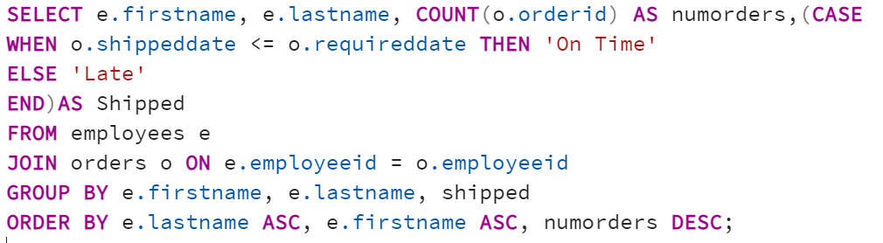
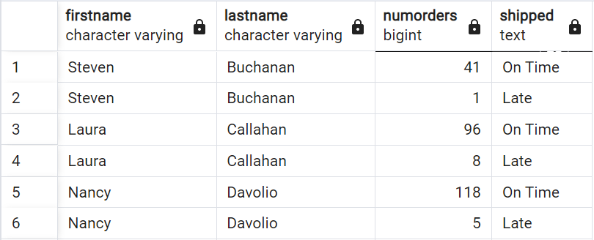
13. Show the employee's first_name and last_name, a "num_orders" column with acount of the orders taken, and a column called "Shipped" that displays "On Time"
if the order shipped_date is less or equal to the required_date, "Late" if the
order shipped late. Order by employee last_name, then by first_name, and then
descending by number of orders.

Slide 16
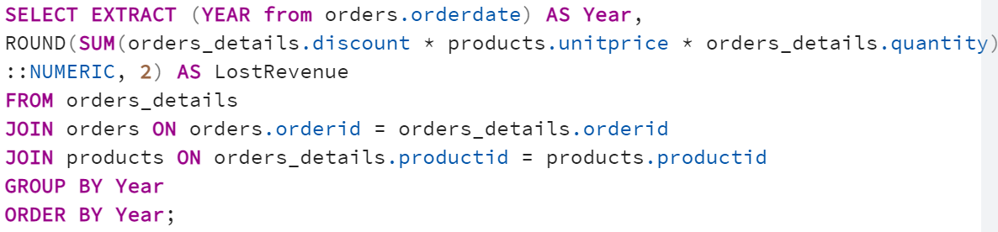
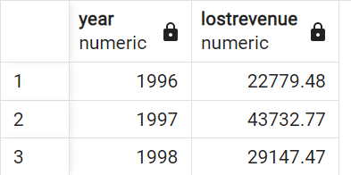
14. Show how much money the company lost due to giving discounts each year, order the years from most recent to least recent. Round to 2 decimal places.

